Slide 1
RDBMS and CRUD Operations
Topics
  Relational Database Management System
  CRUD Operations
Presented by: Abhishek Kumar

Slide 2

What is a Database?
A database is an organized collection of data that is stored electronically and accessed easily.
Examples:
  Student records
  Customer details
  Banking systems
Why we need a database?
  To store large amounts of data
  To retrieve data quickly
  To maintain data securely

Slide 3
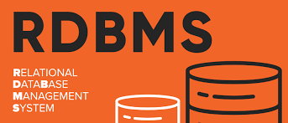
What is RDBMS?
RDBMS stands for Relational Database Management System
An RDBMS stores data in the form of tables (relations) with rows and columns.
Examples:
  MySQL
  Oracle
  PostgreSQL
  SQL Server

Slide 4
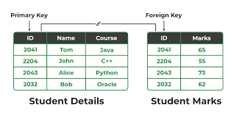
Structure of RDBMS
Tables contain rows and columns
Rows represent records
Columns represent attributes
Keys:
  Primary Key : Uniquely identifies a record
  Foreign Key : Creates relation between tables

Slide 5
Advantages of RDBMS
• Data consistency
• Reduced redundancy
• Data security
• Easy retrieval using SQL
• Supports table relationships

Slide 6
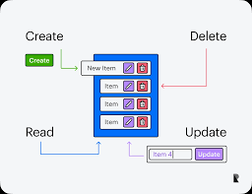
What is CRUD?
CRUD represents basic database operations:
C – Create
R – Read
U – Update
D – Delete

Slide 7
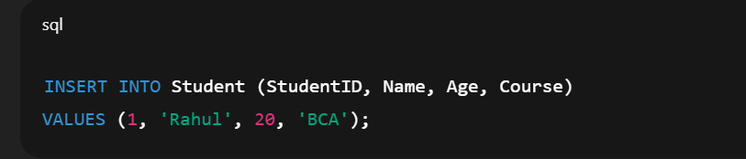
CREATE Operation
Used to insert new data into a table
Use Case:
  New user registration
  Adding a new product
SQL Example:

Slide 8
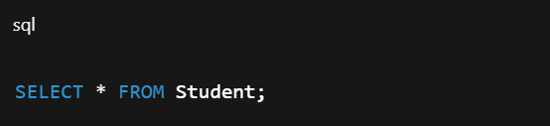
READ Operation
Used to retrieve data from database
Use Case:
  Viewing profile details
  Displaying product list
SQL Example:

Slide 9
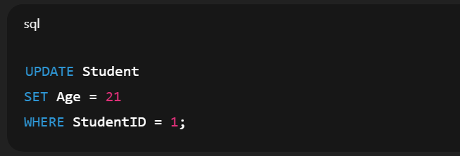
UPDATE Operation
Used to modify existing data
Use Case:
  Updating profile information
  Changing order status
SQL Example:

Slide 10

DELETE Operation & Conclusion
Used to remove data from table
Use Case:
  Deleting inactive users
  Removing cancelled orders
SQL Example:

Slide 11
Thank You

